Slide 1





Collaborative Filtering Algorithms
Group 9
Lingyi Cai
Wenyue Wu
Xiwen Chen
Tong Dai

Slide 2
Collaborative Filtering
Collaborative Filtering (CF) is a method of making automatic predictions about the interests of a user by learning its preferences (or taste) based on information of his engagements with a set of available items, along with other users’ engagements with the same set of items. in other words, CF assumes that, if a person A has the same opinion as person B on some set of issues X={x1,x2,…}, then A is more likely to have B‘s opinion on a new issue y than to have the opinion of any other person that doesn’t agree with A on X.

Slide 3
Datasets
ratings.csv
userId, movieId, rating
100,836 rows
610 Users
9,724 Movies
80 vs 20
Train dataset contain all users and movies

Slide 4
Processes
The goal of this project is to match consumers with most appropriate products by exploring Alternating Least Square along with Temporal Dynamics regularization.
Postprocessing
Generate the effectiveness of our new model and method to increase diversity while maintaining high rating quality
1
Regularization
Designing recommender systems or general customer preference models
2
Factorization Algorithm
Decomposing the user-item interaction matrix into the product of two lower dimensionality rectangular matrices.
3

Slide 5
Method Assignment
Alternating Least Squares (ALS)
Temporal Dynamics
KNN
Kernel Ridge Regression
Algorithms (A3)
Regularizations (R3)
Postprocessing (P2 vs P3)

Slide 6
Matrix Factorization
Matrix factorization methods characterize both items and users by vectors of factors inferred from item rating patterns. High correspondence between item and user factors leads to a recommendation. Matrix factorization generally has 3 parts:
Original matrix R of size m x v with our users, items
Latent are features to tie user and movie together
Convert into into：
one matrix with users and hidden features of size u x f
one matrix with items and hidden features of size f x v

Slide 7
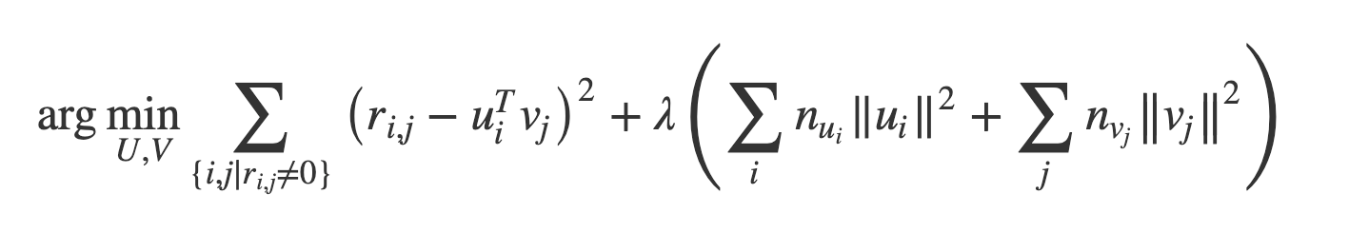
Alternating Least Squares (ALS)
Iterative optimization process where every iteration try to arrive closer and closer to a factorized representation of our original data.
By randomly assigning the values in U and V and using least squares iteratively we arrive at the best weights yield for R.
The least squares approach simply means fitting some line to the data, measuring the sum of squared distances from all points to the line and trying to get an optimal fit by minimizing this value.
With the alternating least squares approach we use the same idea but iteratively alternate between optimizing U and fixing V and vice versa. We do this for each iteration to arrive closer to R = U x V.
Step 1:
Initialize matrix M by assigning the average rating for that movie as the first row, and small random numbers for the remaining entries.
Step 2:
Fix M, Solve U by minimizing the objective function (the sum of squared errors);
Step 3:
Fix U, solve V by minimizing the objective function similarly;
Step 4:
Repeat Steps 2 and 3 until a stopping criterion is satisfied.

Slide 8
Temporal Dynamics
Customer preferences for products are drifting over time.
Product perception and popularity are constantly changing as new selection emerges.
Customer inclinations are evolving, leading them to ever redefine their taste.
When intersecting multiple products and customers, many different characteristics are shifting simultaneously, while many of them influence each other and often those shifts are delicate and associated with a few data instances.
A model tracking the time changing behavior throughout the life span of the data. This allows us to exploit the relevant components of all data instances, while discarding only what is modeled as being irrelevant.
Data is changing over time, and up to date modeling should be continuously updated to reflect its present nature

Slide 9
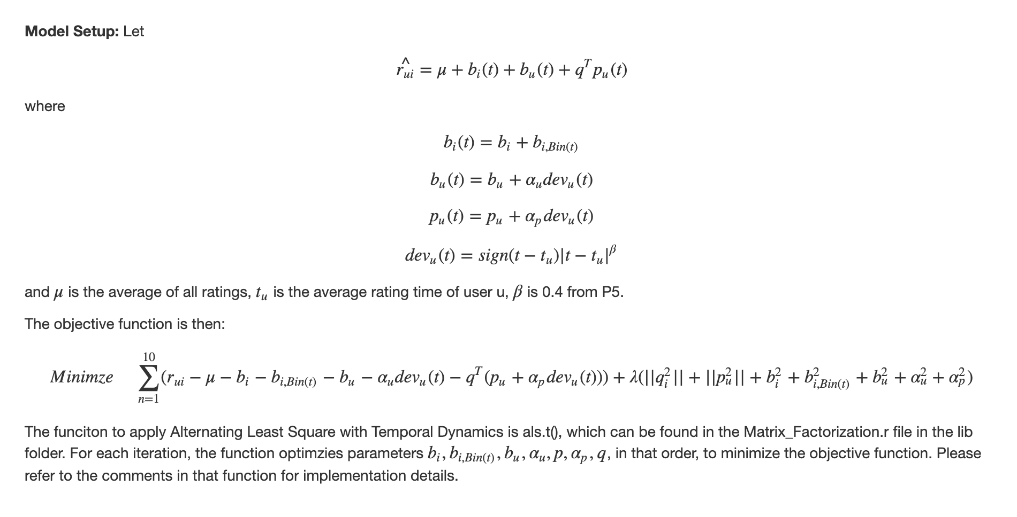
ALS - Final
Notes:
Time change movie component
Time changing user component
Time changing user Affinity
Predictive Rating Model
Each part can be broken down to stationary component and time moving component
Objective function – base model + temporary dynamic

Slide 10
Parameter Tuning
After running cross validation, we can see that the parameter set
f = 10, lambda = 0.1 gives us the best outcome. Furthermore, running 3-4 iterations is enough to get the best result.
Notes:
Lambda is regularization parameter
After 4 times, we run into overfitting issues, so 5fh is the best

Slide 11
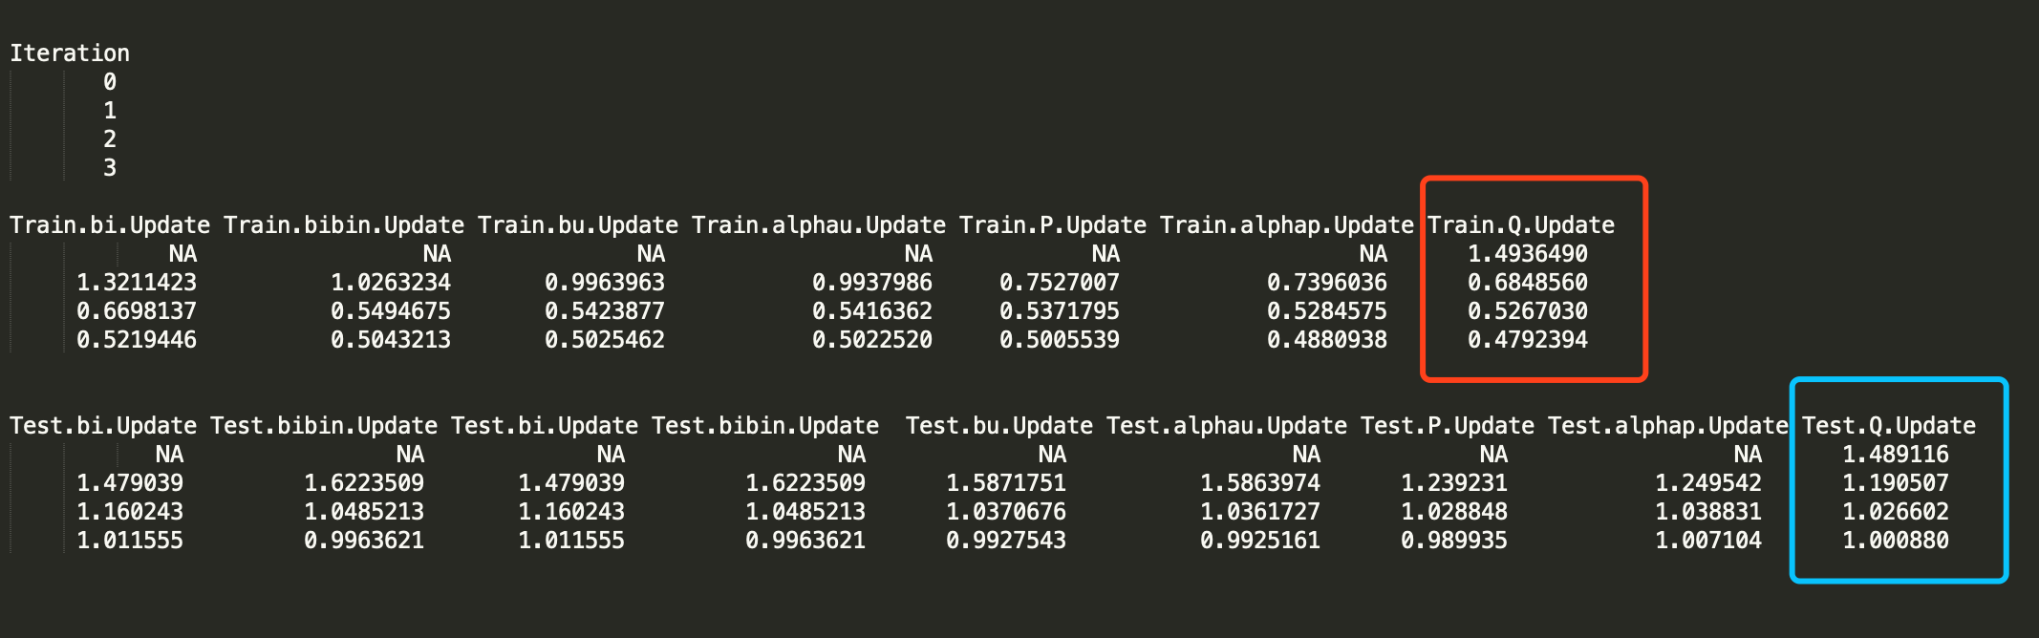
Fitting the model with the optimized parameters

Slide 12



Postprocessing K-Nearest Neighbors (KNN) (P2) vs Kernel Ridge Regression (P3)
After matrix factorization, postprocessing will be performed to improve accuracy.
We use Postprocessing SVD with KNN (P2) and Postprocessing SVD with kernel (P3) to do postprocessing.
Notes:
Kernel Ridge Refressiion -

Slide 13
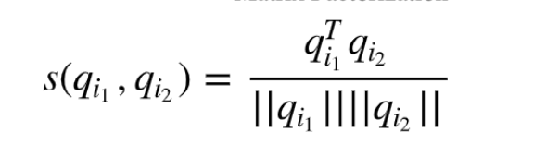
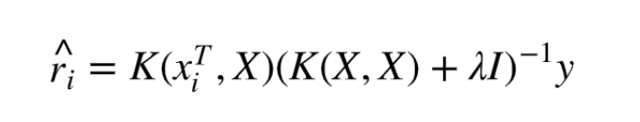
K-Nearest Neighbors (KNN) (P2)
Use formula to find similarity, then every user perform regression
Kernel Ridge Regression (P3)
For every user, we also ran apply same methologody
Notes:
KNN - Use formula to find similarity, then every user perform regression
KRR – calculate regression

Slide 14





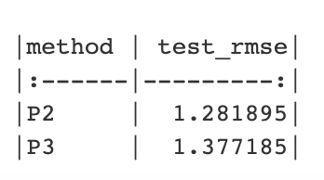



Evaluation
The test_rmse of Postprocessing SVD with KNN (P2) is smaller, so we can conclude given A3 + R3, P2 is better than P3.

Slide 15
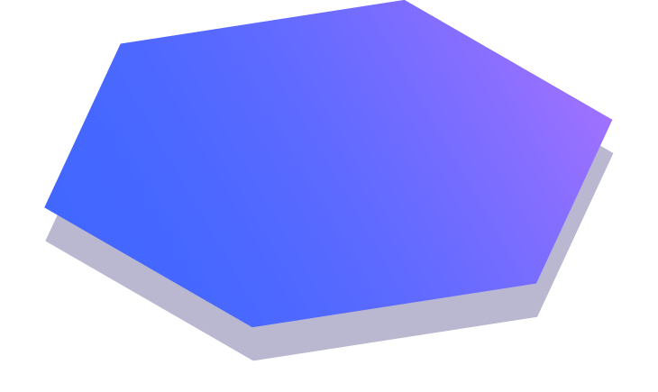
Thanks!

